Slide 1
Election Analysis
Erma, Hiep, Jason, Mike, Blake

Slide 2
Project Summary: The United States Senate
For our final group project, we are examining U.S. Senate election results.
We’re looking specifically at the relationship between election results and:
Senate election campaign spending
State demographics
Changing partisan trends
Voter turnout

Slide 3
Why the Senate?
Given the standing of the U.S. in global affairs, U.S. Senators are some of the most powerful people in the world
The Senate is arguably the most important legislative body in the United States
Given the structure of the Senate, for example with filibuster rules that generally require 60 votes for legislation to pass, most legislation that passes in the House does not pass the Senate
This is especially the case in today’s polarized and highly partisan environment
We set out to understand how much it costs to become a U.S. Senator. We also set out to understand what happened in 2020 in regards to the Senate and what that means for the midterm elections and beyond.

Slide 4
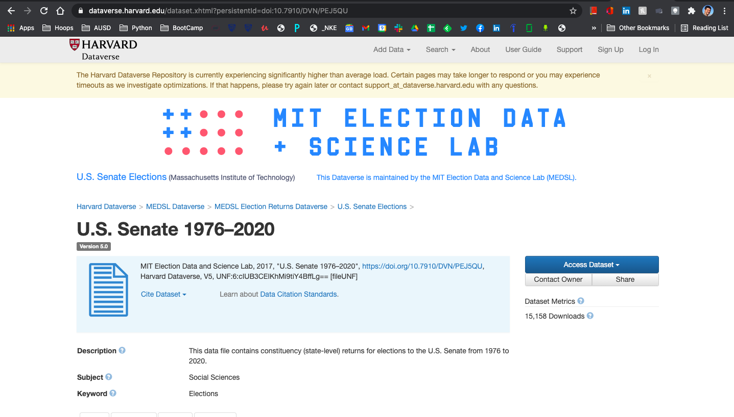
Datasets - U.S. Senate 1976-2020
MIT Election Data and Science Lab
100 U.S. Senators
Six-year terms
About 33 elections every two years
~1500 elections
Source: https://dataverse.harvard.edu/dataset.xhtml?persistentId=doi:10.7910/DVN/PEJ5QU

Slide 5
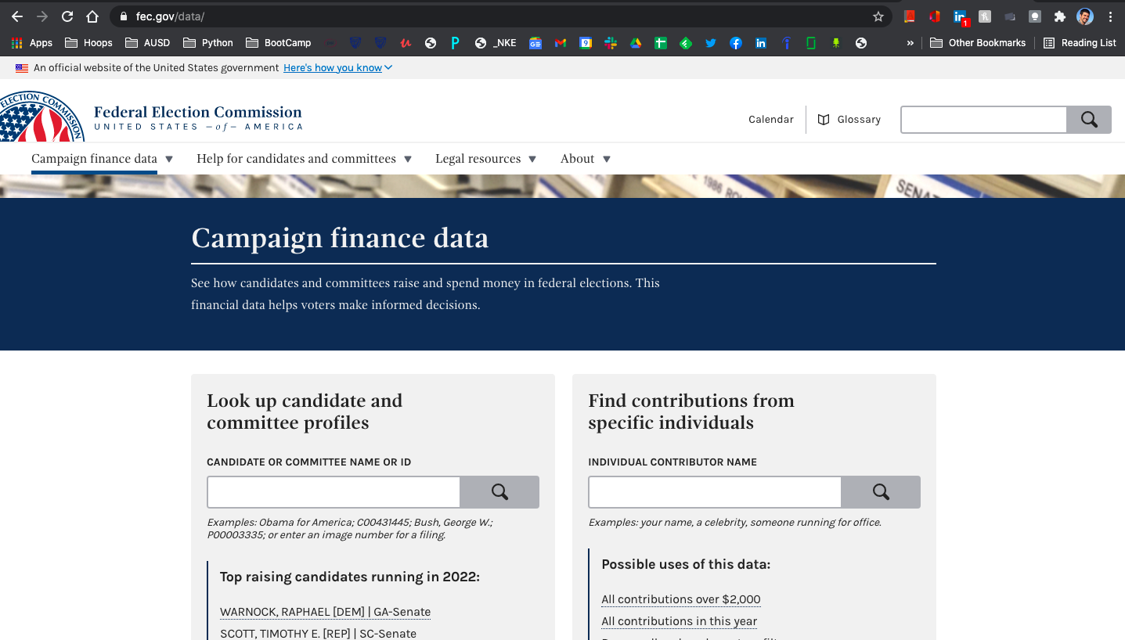
Datasets - FEC
Federal Election Commission (FEC) reports (2004-2020)
$14 billion spent in total on 2020 federal elections
Previous record <$7 billion (2016)
Campaigns are required to report every dollar they spend, and how it’s spent
Correlation not necessarily causation
OpenSecrets.org
Source: https://www.fec.gov/data/

Slide 6
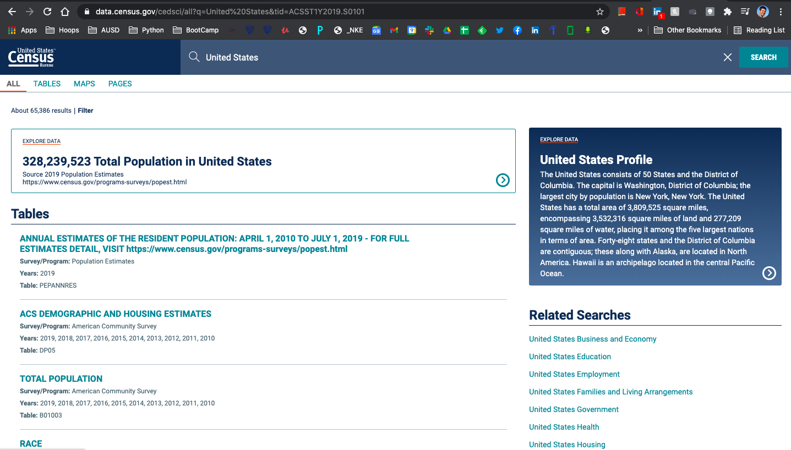
Datasets - U.S. Census
U.S. Census every ten years, but most recent data (2020) just being released now
Last official “Decennial Census” data is from 2010
In 2005 the U.S. Census Bureau launched the American Community Survey, population and demographic data collected monthly and reported annually
Source: https://data.census.gov/cedsci/

Slide 7
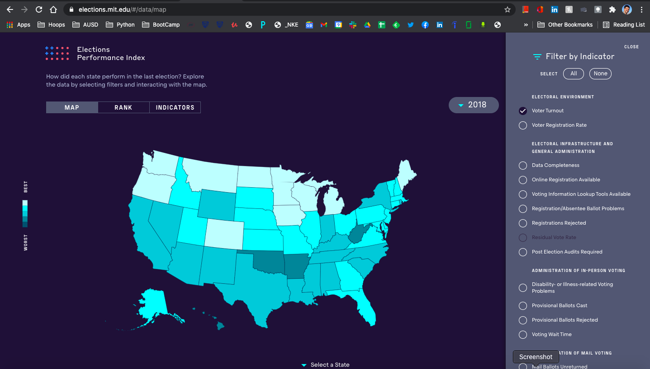
Datasets - Elections Performance Index
MIT Election Data and Science Lab
Compares election administration policy and performance across states and over time
Indicators include registration rates, how many ballots are rejected, wait times in line
VEP turnout
Source: https://elections.mit.edu/#/data/map
Notes:
Together, these datasets tell us a lot about the state of voting in the U.S. in recent history and today.

Slide 8
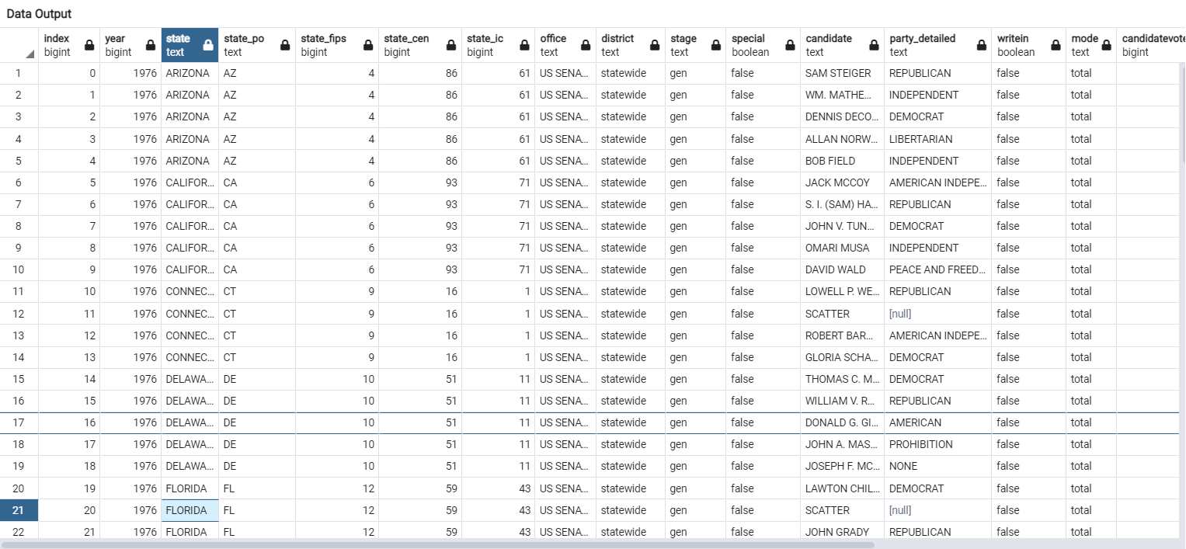
Senate Data
With this dataset alone, tracking victory since 1976, can be used to predict winners based on trends. By combining this dataset with others that help us understand where and why the nation is changing, we can build an accurate model to predict how and why different candidates can win in purple states.

Slide 9
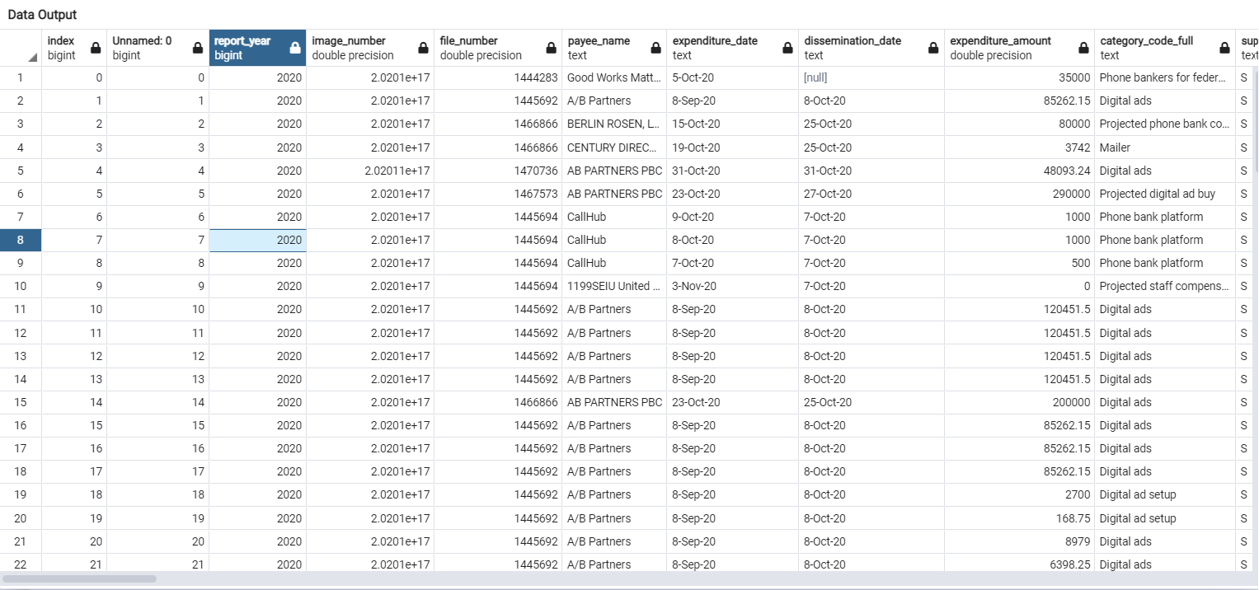
FEC Data
Understanding not only how much but also on what campaigns spend their money is essential to deconstructing how the senate works, and how to better run campaigns.

Slide 10
Data Exploration Phase
Our group was formed around an interest in federal election-related data as this information reveals a lot about our democracy, and similar to the hope we have for fair elections with high turnout, our group also wanted to find unbiased, robust datasets.
Focusing on the U.S. Senate, we tracked down a dataset of election results data for all elections between 1976-2020.
We also found demographic data for the states we are analyzing.
The Federal Election Commission requires the reporting of all “hard money” campaign contributions. These contributions are those that go toward advertisements that explicitly tell voters which candidate to vote for or against (as opposed to “soft money” contributions toward party-building activities). We located multiple contribution datasets and joined them to form a record of hard money contributions to U.S. Congress races between 2004-2020.
Finally, we chose a data set from the Elections Performance Index, a project from MIT’s Election Data and Science Lab. This index “compares election administration policy and performance across the states and from one election cycle to the next.” This is helpful for indicators that can be compared state-to-state and over time, such as voter turnout.

Slide 11
Database
The database has several different interacting datasets
The information ranges from 1976-2020
Most of the data overlaps from 2000-2020
We plan to use our database to better understand how spending influences the success of political candidates
We have data that helps us not only understand spending, but also turnout in the several states we intend to use.
Demographics and turnout will also be considered in relation to spending and victory

Slide 12
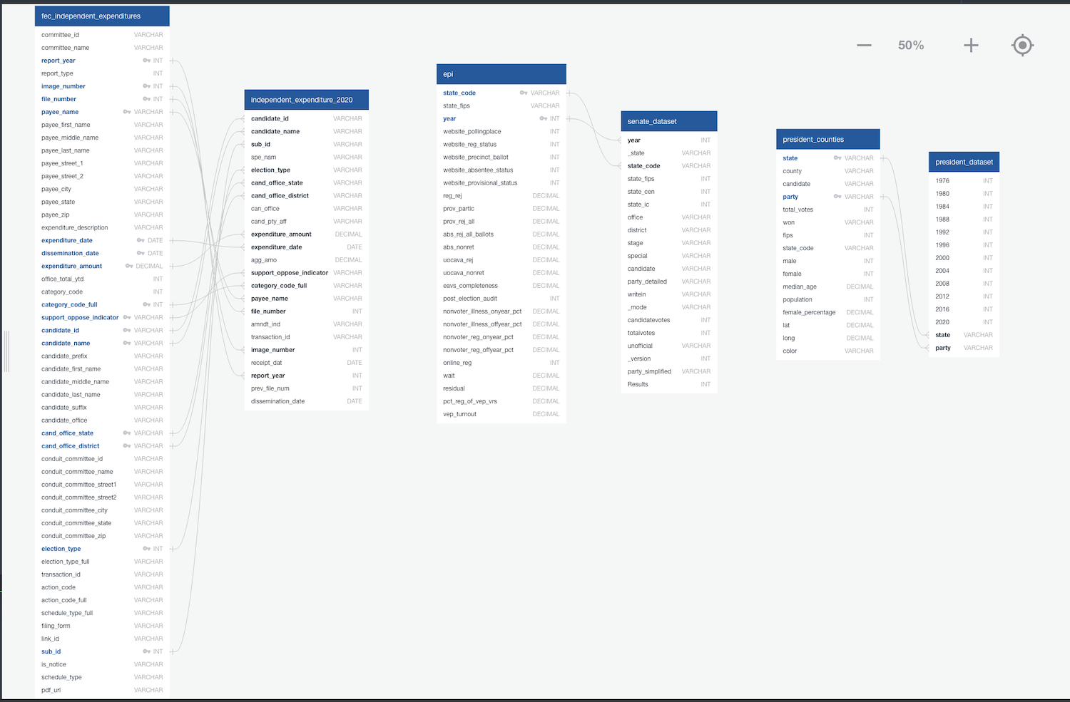
Database Tools
The tools we used to build our database were:
Postgres (PgAdmin) to import our data and to construct our new tables
AWS to allow collaboration across multiple users
DBdiagram for mapping - keys were fairly easy to find, tables were huge
Year, parties, states, etc.

Slide 13
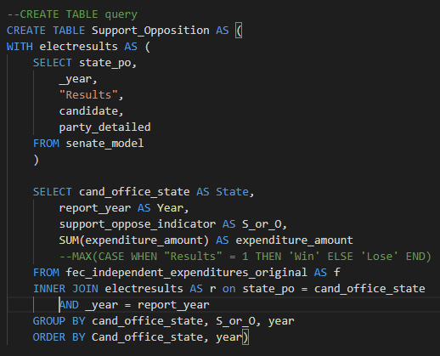
Table join
Subqueries to help with optimization
Changed 30 column table to 5 columns
Grouped on States, Years

Slide 14
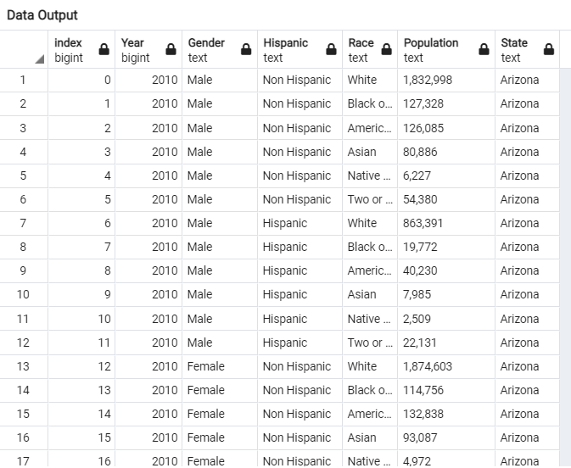
Demographic Information
This data is important because it not only tells us how many people turned out to vote, but who voted.
Winning elections is becoming more and more of a science, and understanding demographics and how to reach them is essential to victory.

Slide 15
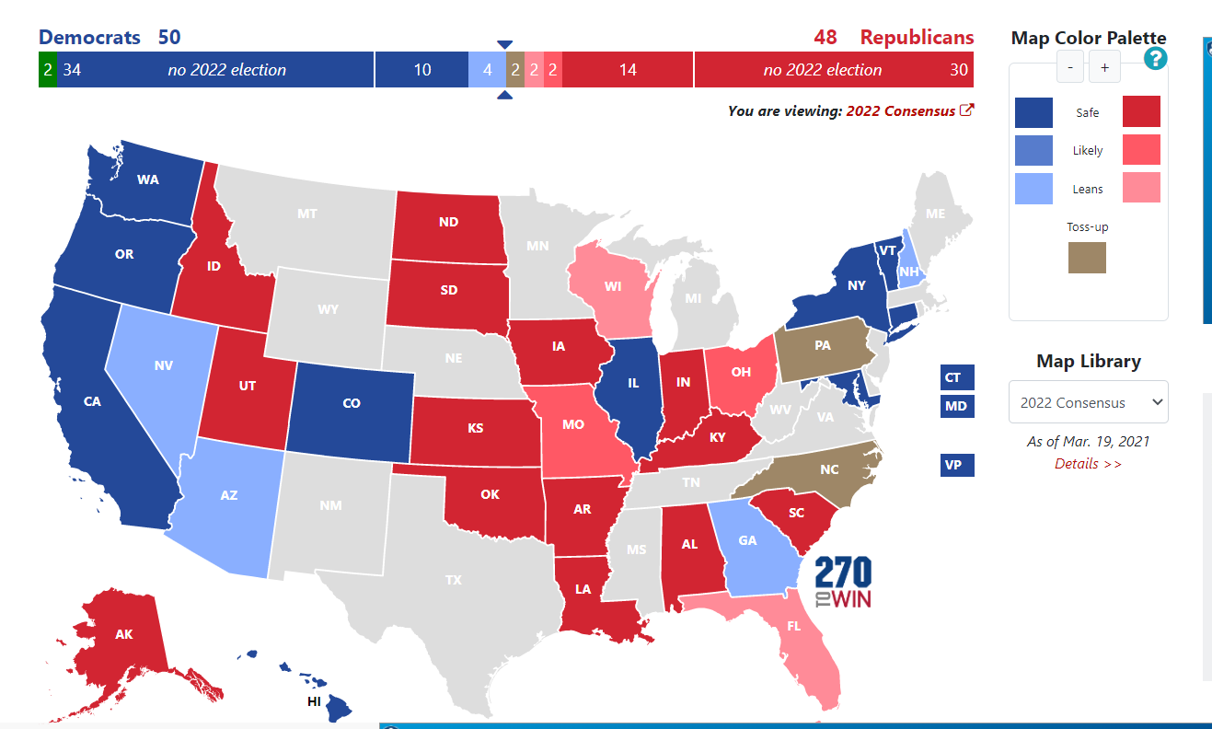
Competitive States
Georgia
Pennsylvania
Ohio
Arizona
Colorado
New Hampshire
South Carolina
We chose these states because they have a wide range of demographics, histories, and cultural differences. We hope to balance the states that lean blue with those that lean red and states from similar regions of the country with one another.
Note: We have chosen solid blue/red states to test our model and make sure it is working properly

Slide 16
Tableau
We will use Tableau to create interactive dashboards for users to analyze senate data
There will be dynamic filters which allows users to drill down to make more advanced analysis
Add a hyperlink feature that switches back and forth between the Tableau dashboard and machine learning application
https://public.tableau.com/profile/jason6879#!/vizhome/SenateRace_16205139382310/Dashboard1?publish=yes

Slide 17
Machine Learning
Link
https://share.streamlit.io/hieppham8083/finalproject/main/main.py
https://predictsenate.anvil.app/

Slide 18

So what does this all mean?
Elections are becoming more and more expensive
Citizens United decision (2010)
Battle ground states are shifting
Demographics play a key role in winning elections
Money talks

Slide 19
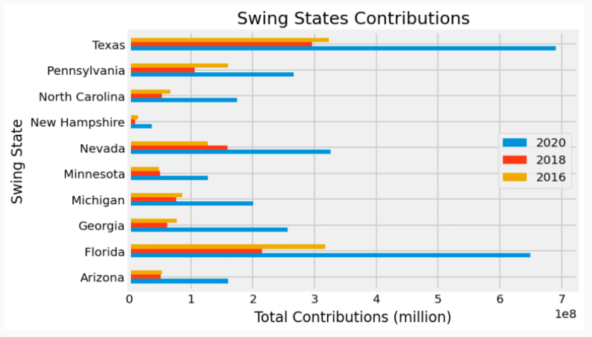
Party politics - Swing States
Swing state contributions
We can see Texas is becoming the new battleground state in the minds of the american political donors and the elite who make large contributions
Florida remains a very heavily invested in state
Spending in swing states in 2016 was much lower than average
Pay attention to the 2016 margin for democrats in Minnesota
Notes:
Texas is gaining traction and attention from donors
Regardless of actual ability to swing the state it appears
Minnesota got fewer donations in 2016, could explain the margin on the next slide

Slide 20
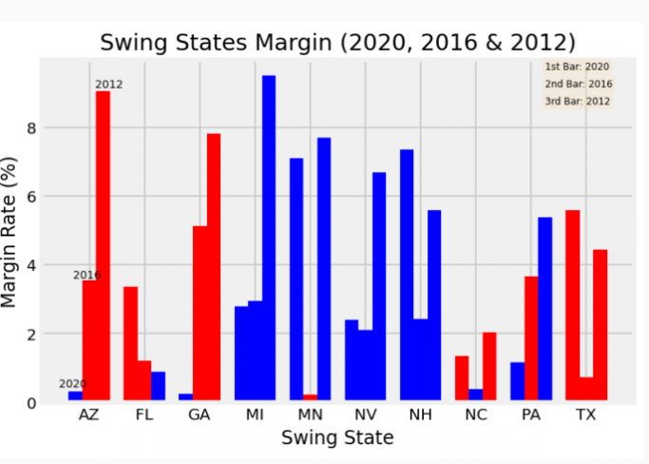
Party Politics Cont’d
Swing state margins
Florida has become much redder and the margin of victory may soon be too great for democrats to overcome in a statewide election
The Democrats victory in Arizona and Georgia was razor thin
demographic shifts in those states could explain this
North carolina has a Republican lean, but is not unwinnable for Democrats
Pennsylvania truly is perhaps the greatest swing state
But does not pull the same kind of spending as other states like florida and texas
Texas appears solid red by the numbers but continues to pull in the most money
Could indicate bad voter rights laws
Further analysis of demographic and voter turnout data could help us understand what is happening there
Notes:
-Arizona and georgia are such small margins
-demographics might explain this
- texas doesnt appear to be swingable

Slide 21
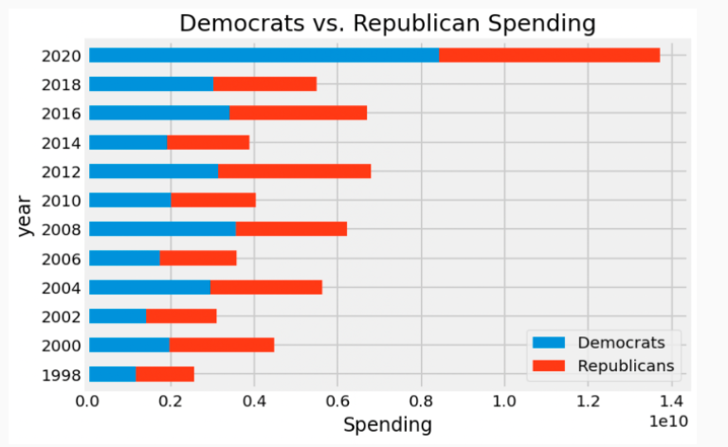
Spending by party
Our analysis tells us that the greater spender typically wins the election in swing states.
Democrats typically spend more than Republicans on Senate elections
Democrats hardly ever have a majority beyond 51 votes in the Senate.
This can tell us that while you need a lot of money to win senate seats, the constitutional rules of the senate gives an advantage to Republicans
Money cannot beat the fact that the senate does not proportionally represent the American People.
Notes:
-democrats spend more, but cant get an absolute majority no matter how much they spend
- spending is increasing rapidly since citizens united in 2010

Slide 22
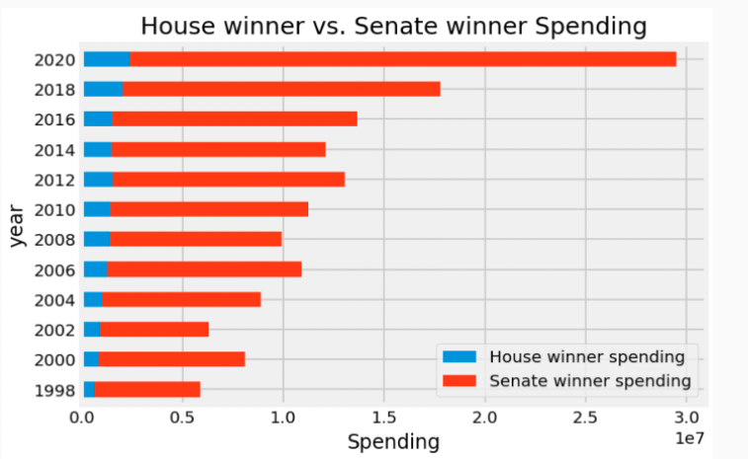
Spending
Senate campaign spending outpaces House campaign spending dramatically
It is clearly much more expensive to become a U.S. Senator than it is to be elected to the House of Representatives.
This means Senators need to find donors with deeper pockets in order to win elections.
This could explain why the Senate fails so often to pass legislation to help the American people. Both parties need excessive amounts of money to win Senate seats and therefore need to accept money from corporate donors.
This has also gotten considerably worse over the last ten years (after the citizens united decision)
Notes:
The senate is more susceptible to corruption and corporatism because of how much is costs to become a senator

Slide 23

Don’t Forget to Vote every TWO years!
Living in a democracy is a privilege and a responsibility! To maintain it we all must participate.

